Slide 1
Riding on a Turtle’s Back, Continued
Diogo Monteiro, 97606
Introduction to Computer Graphics – 2021/2022 – Project 2

Slide 2
What’s New
Textures and bump maps
New user interaction with keypresses and clicks
New library added: Projector
Available on https://diomont.github.io/ICG_projeto2/
(might be a bit laggy)

Slide 3
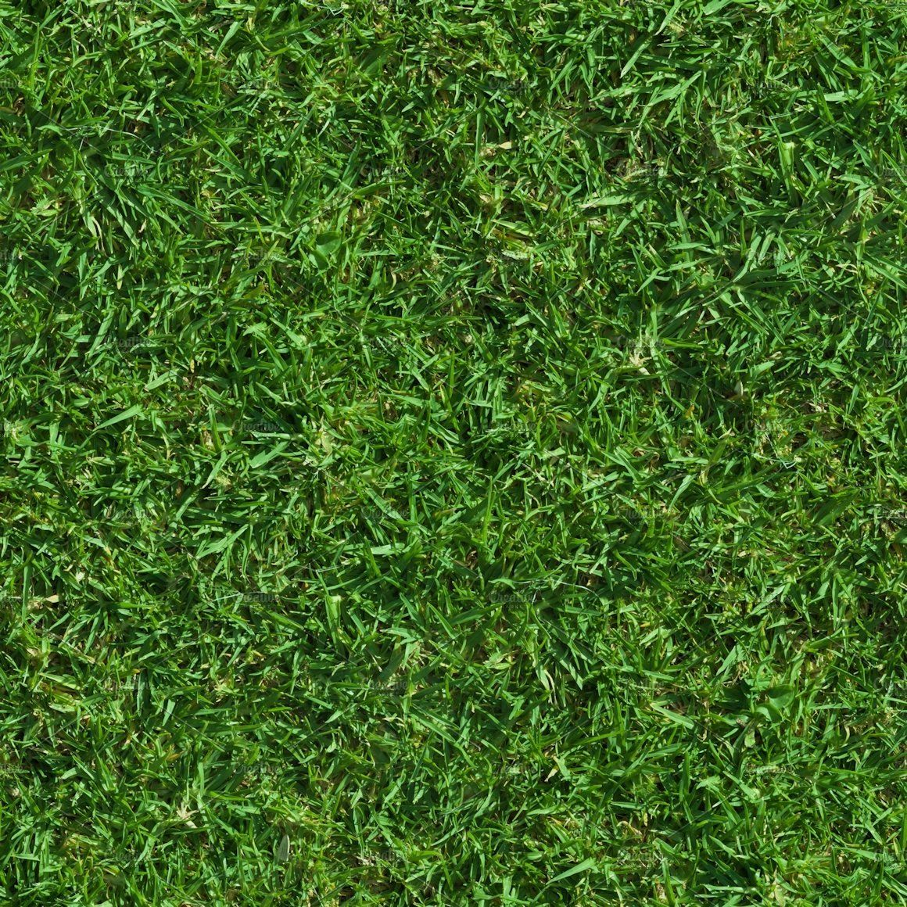
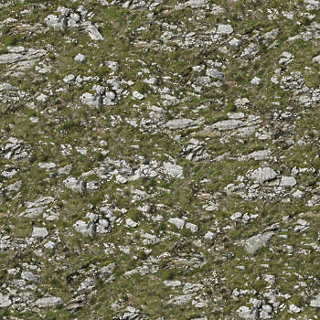
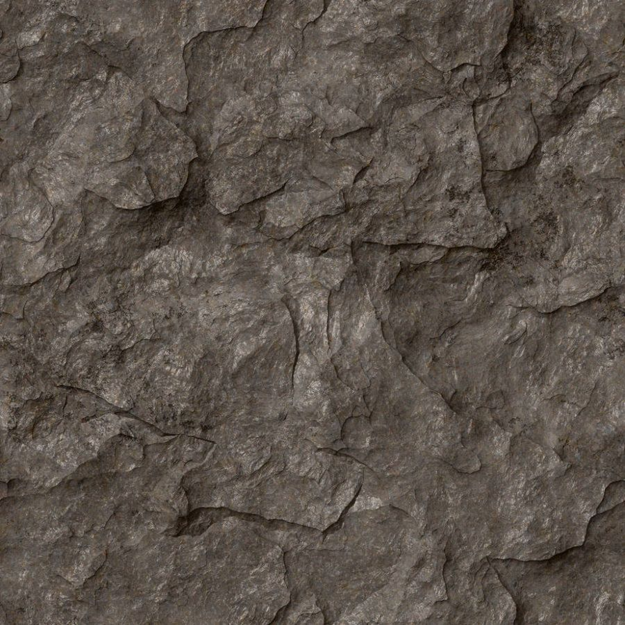
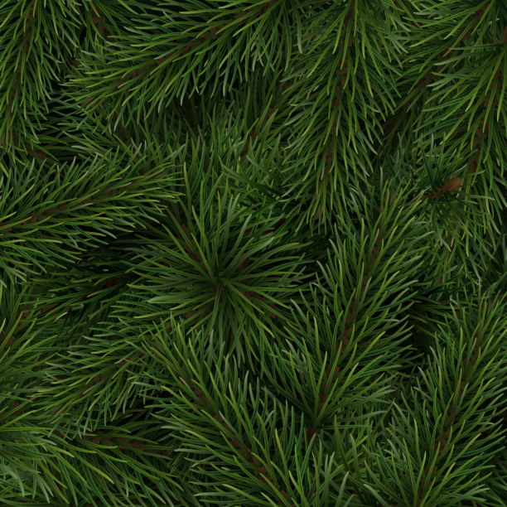
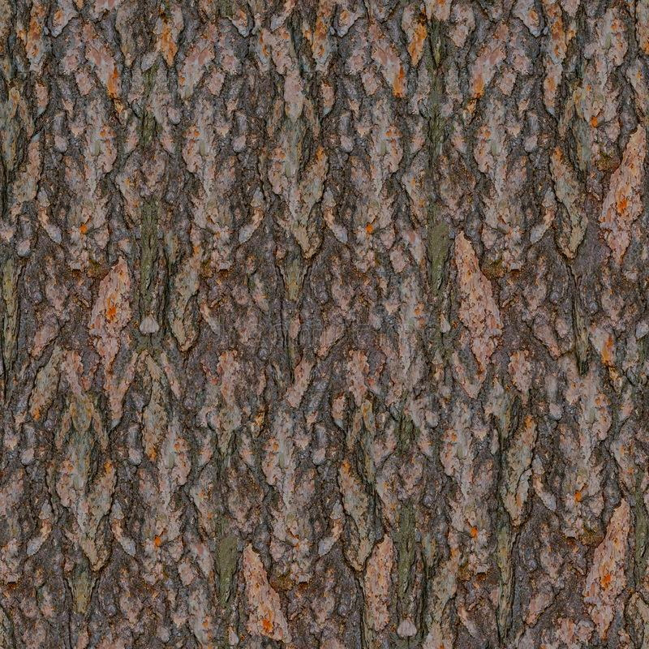
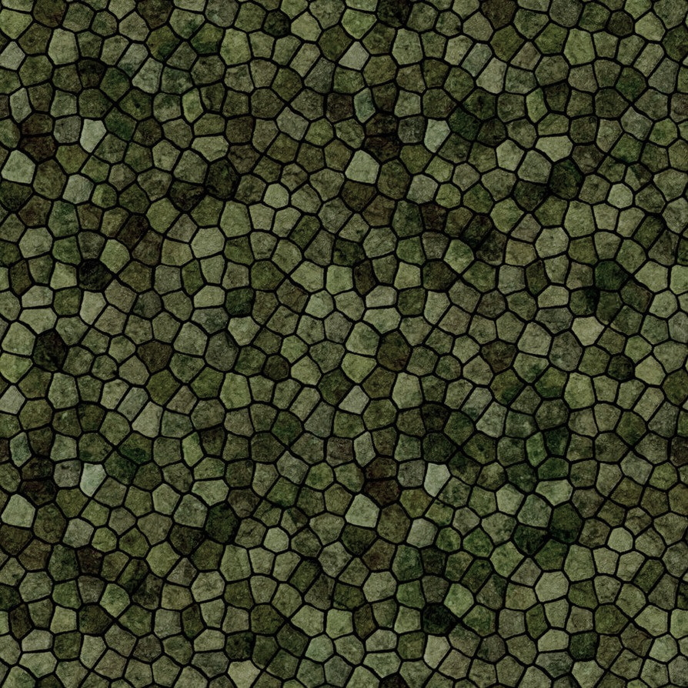
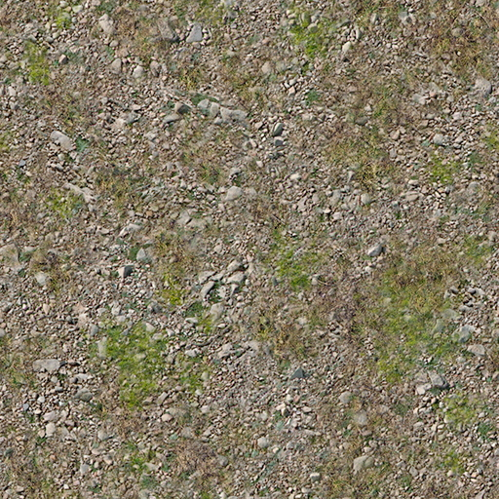
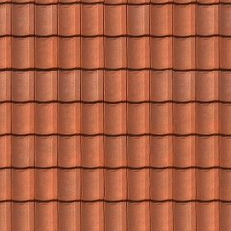
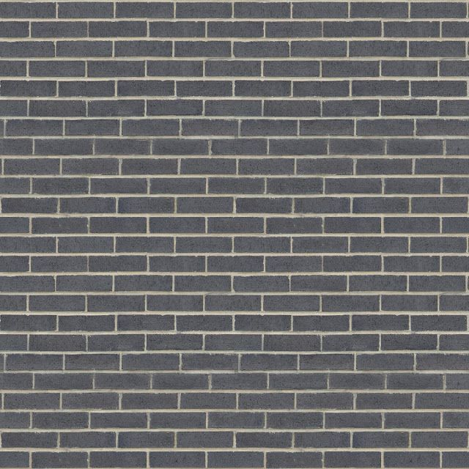
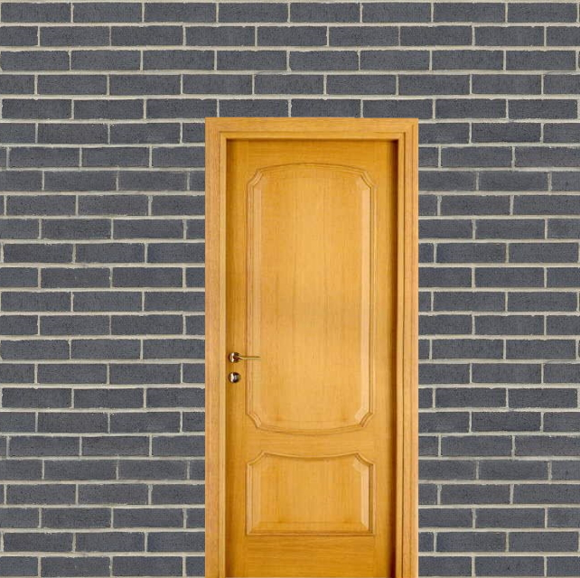
Textures
grass
grassy_rock
rock
pine_needles
pine_tree_bark
turtle_skin
turtle_top
roof
wall
wall_door

Slide 4
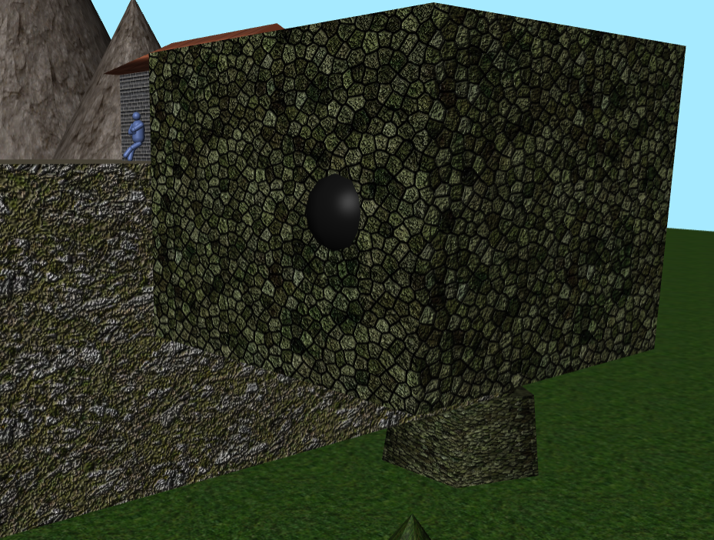
Bump Mapping
Some objects had a bump map assigned
For this, the same image as the texture was used

Slide 5
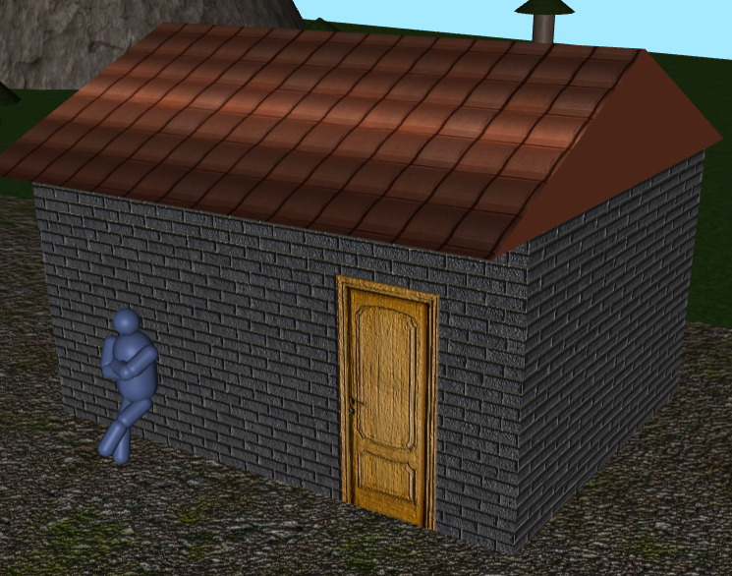
Different Textures On Different Faces
Some objects needed diferente textures on certain faces
For instance, wall with a door, side of the roof
Multiple materials are created and used to make the Mesh

Slide 6
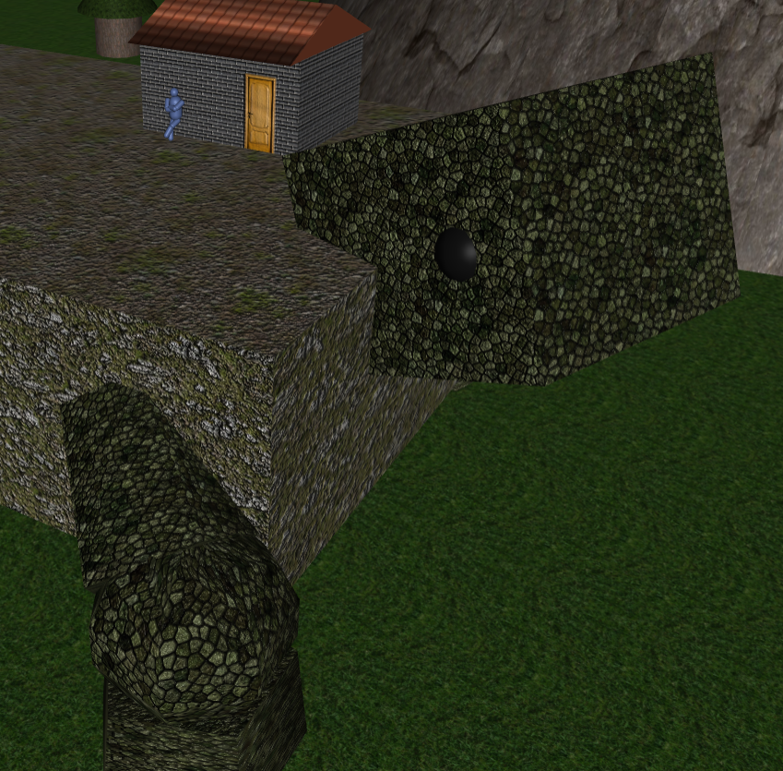
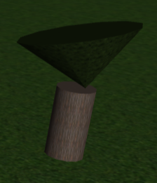
User Interaction
The turtle’s head can be controlled with the WASD keys
Clicking on trees will destroy them

Slide 7
Conclusions
Mapping is pretty neat!
Could have messed with material properties like shininess and played around with reflective surfaces

Slide 8
References
Three.js documentation
Past pratical guides and examples

